Slide 2








Ceph: An Open Source Object Store
Evan Harvey
Gustavo Rayos
Nick Schuchhardt
Mentors: David Bonnie, Chris Hoffman, Dominic Manno

Slide 3
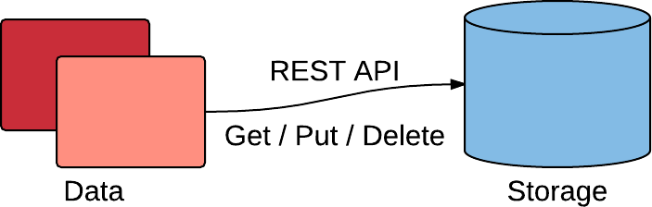
What is an Object Store?
Manages data as objects
Offers capabilities that are not supported by other storage systems
Object Storage vs. Traditional Storage

Slide 4

What is Ceph?
An object store and filesystem
Open source and freely available
Scalable to the Exabyte level

Slide 5
Basic Ceph Cluster
Monitor Node
Monitors the health of the Ceph cluster
OSD Node
Runs multiple Object Storage Daemons (One daemon per hard drive)
Proxy Node
Provides an object storage interface
Can interact with cluster using PUT/GET operations
Provides applications with a RESTful gateway to the Ceph storage cluster

Slide 6
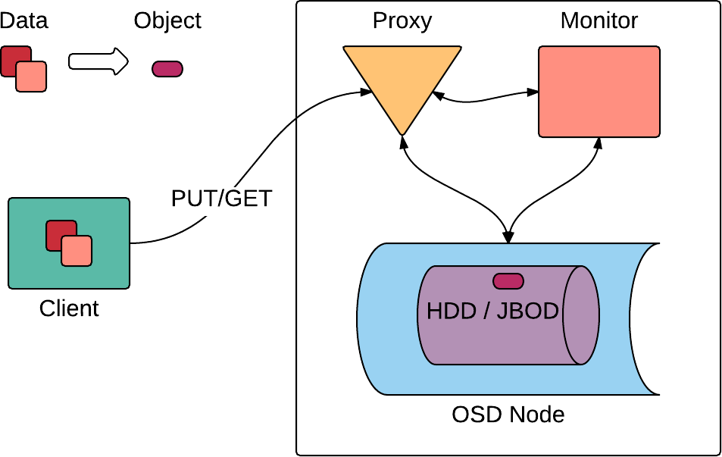
Basic Ceph Cluster

Slide 7

But Why?
Campaign Storage
More reliable than other file systems
POSIX compliant
Scales better than RAID
Cost efficient

Slide 8
Project Goals
Build a Ceph storage cluster
1 Monitor node
6 OSD nodes (Around 20 OSD daemons each)
3 proxy nodes
Erasure coding profiles
Single vs. Multiple proxies

Slide 9
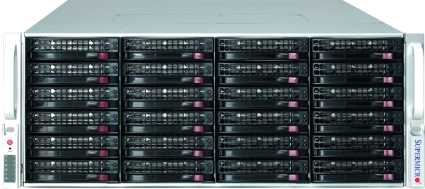
Test Environment
CentOS 6.6
Ten HP ProLiant D380P Gen8 Servers
Three Supermicro 847jbod-14 (45 disks each)
Mellanox Infiniband 56 Gb/s
Two SAS cards 6 Gb/s
8 ports at 600 MB/s
Four Raid cards 6 Gb/s
8 PCI Express 3.0 lanes

Slide 10
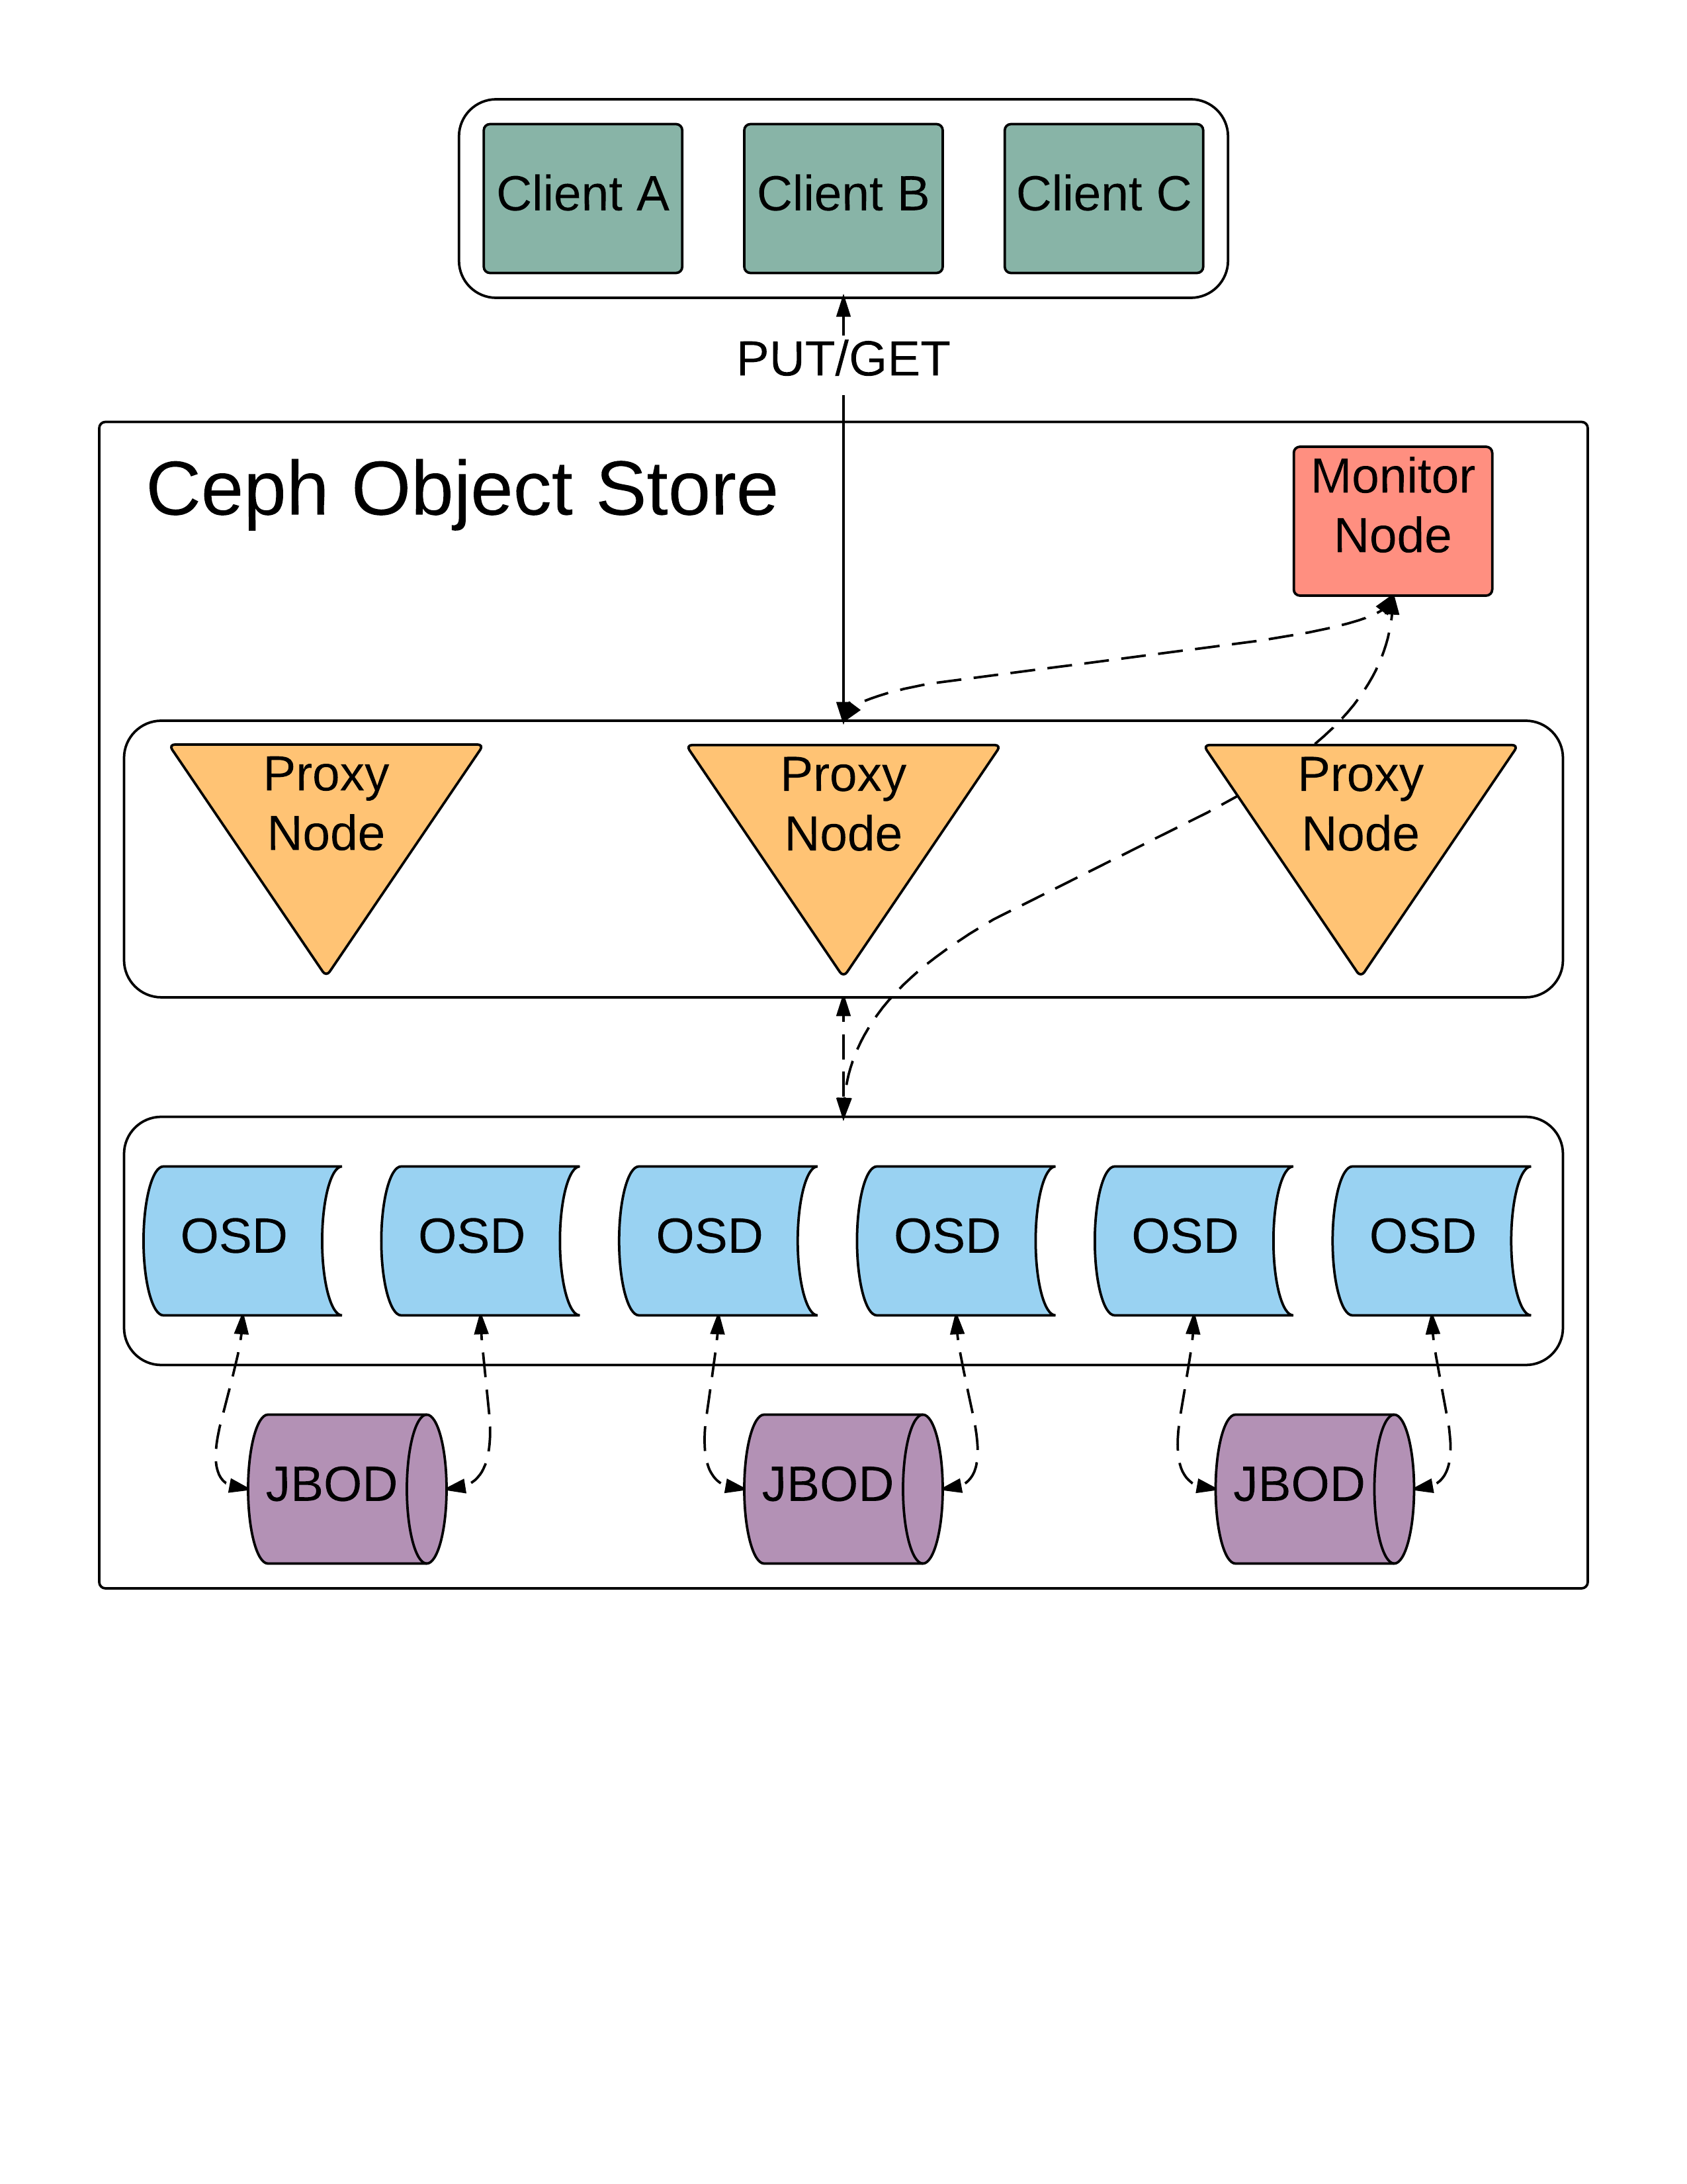
Our Set Up

Slide 11
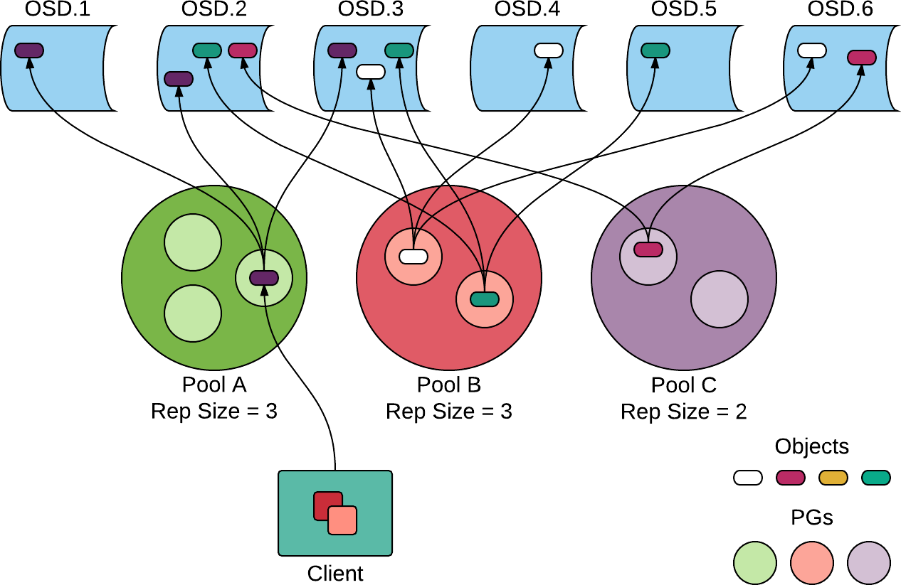
Pools and PGs

Slide 12

Pools and Placement Groups
An object belongs to a single placement group
Pools group placement groups
Placement groups belong to multiple OSDs

Slide 13

CRUSH!
Controlled Replication Under Scalable Hashing (CRUSH)
Algorithm finds optimal location to store objects
Stripes objects across storage devices
On the OSDs
12

Slide 14
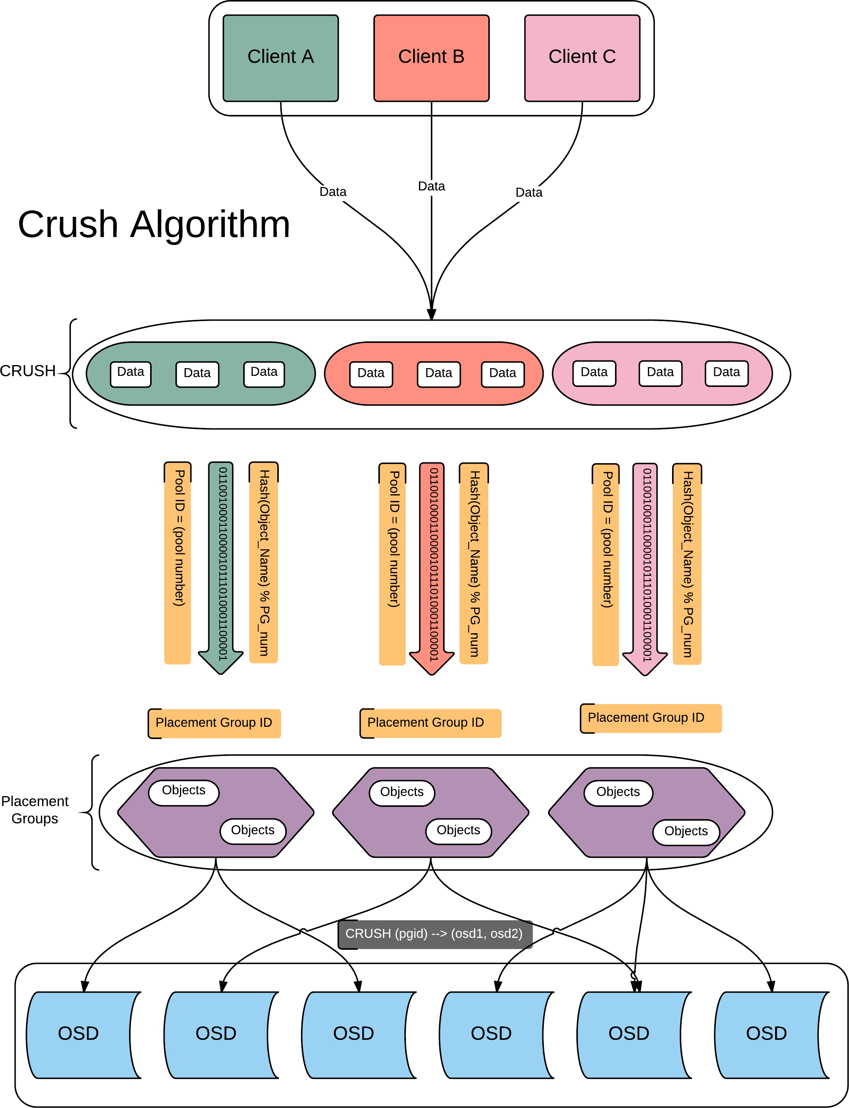

Slide 15
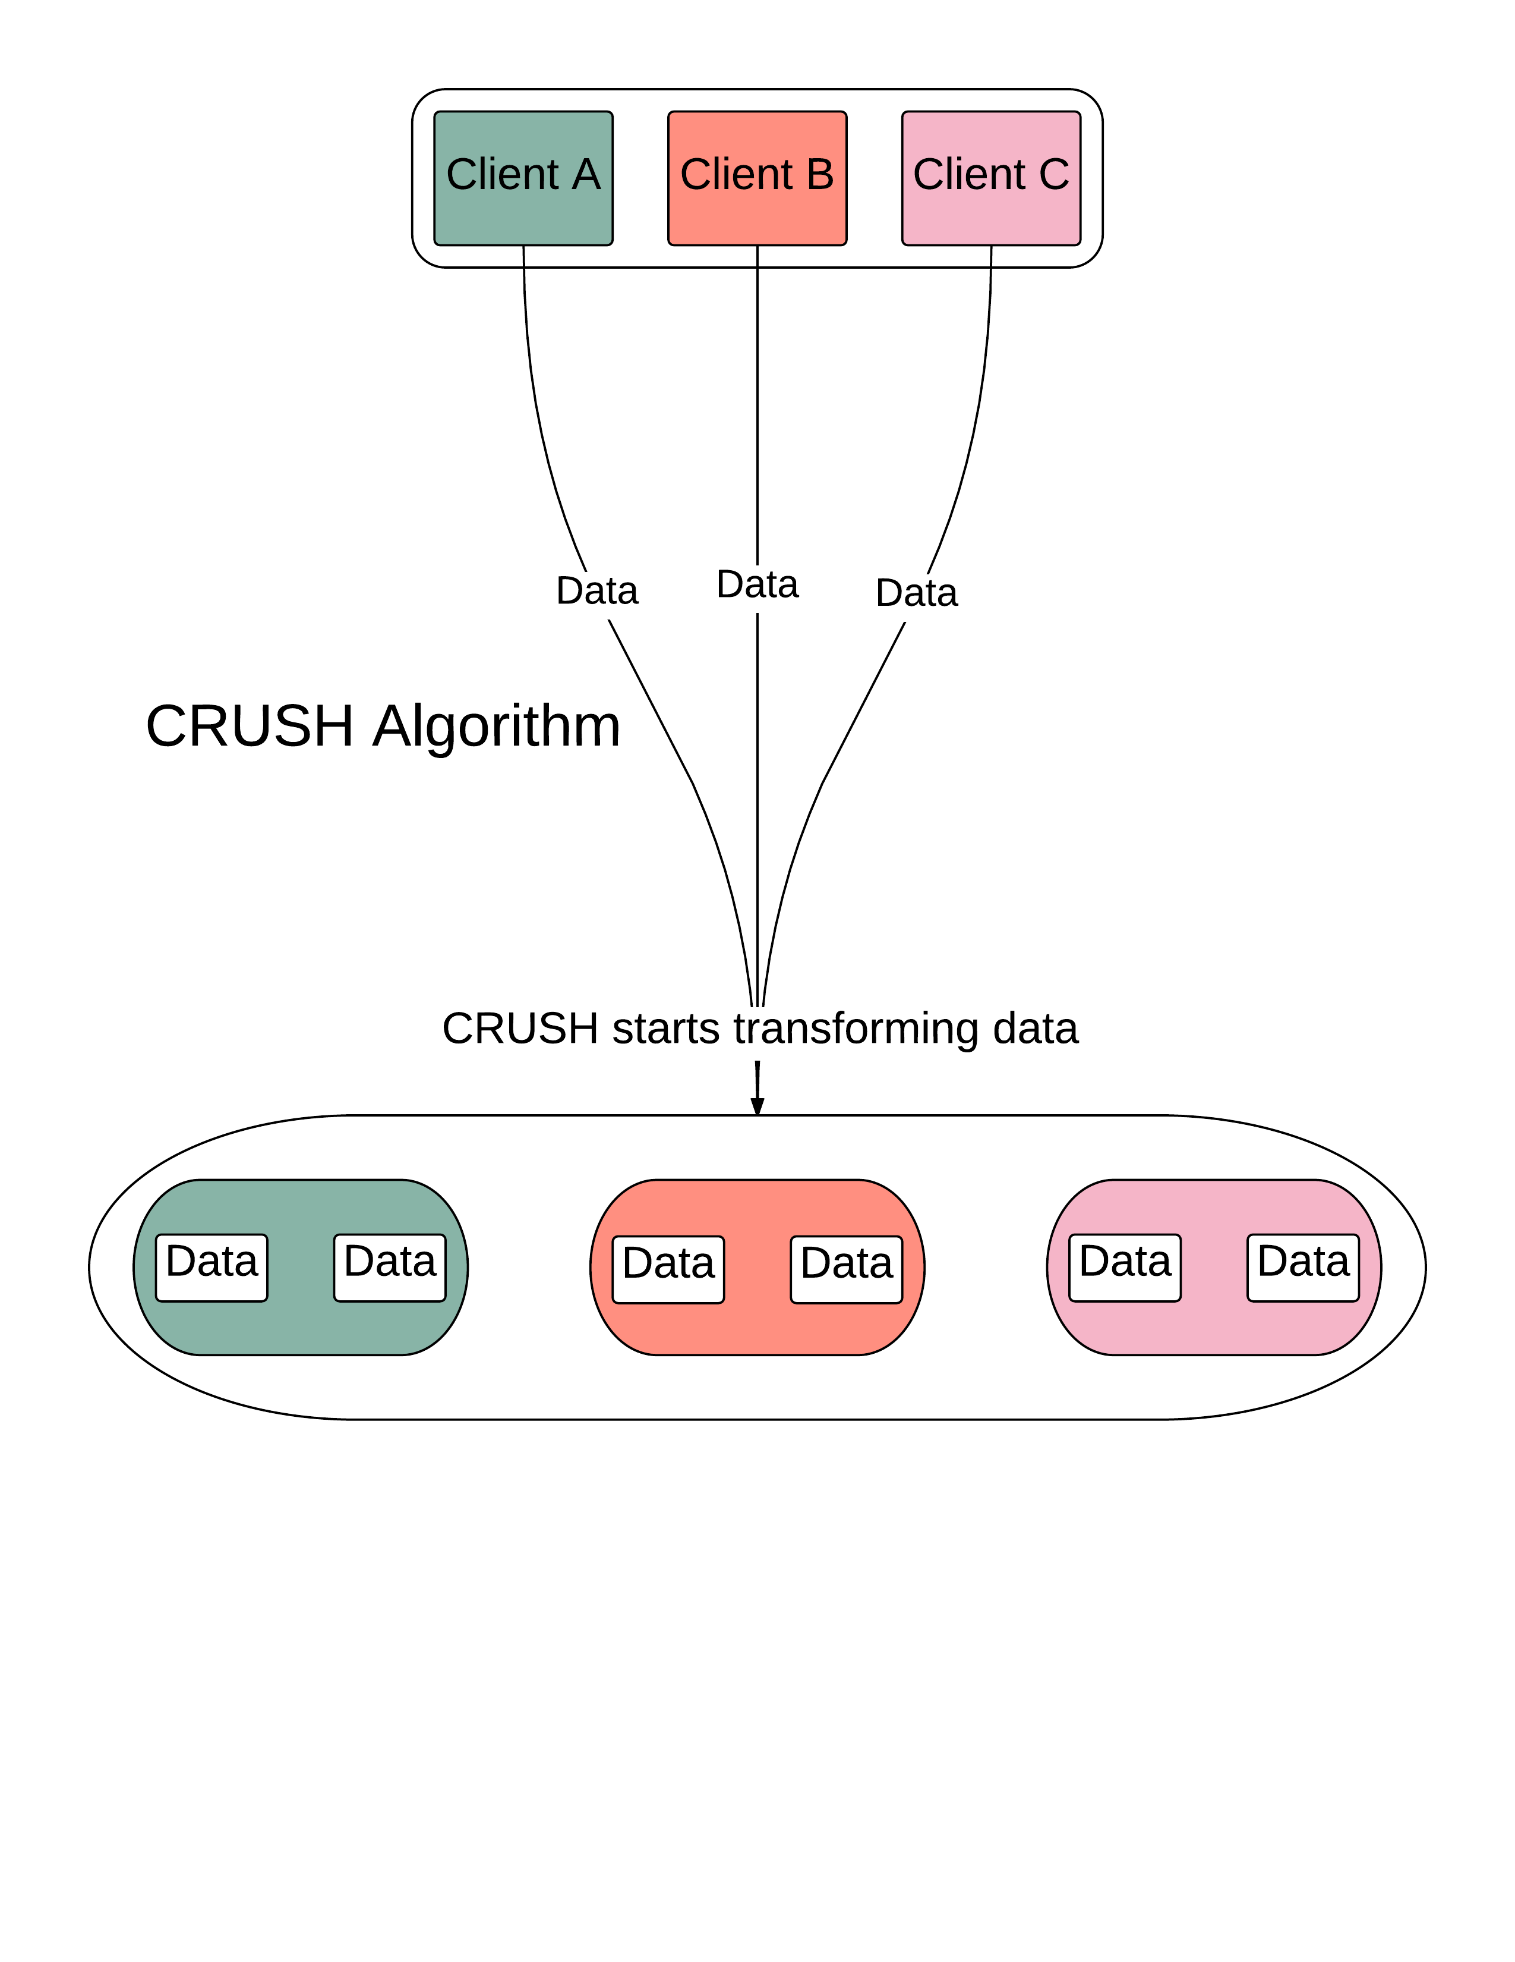

Slide 16
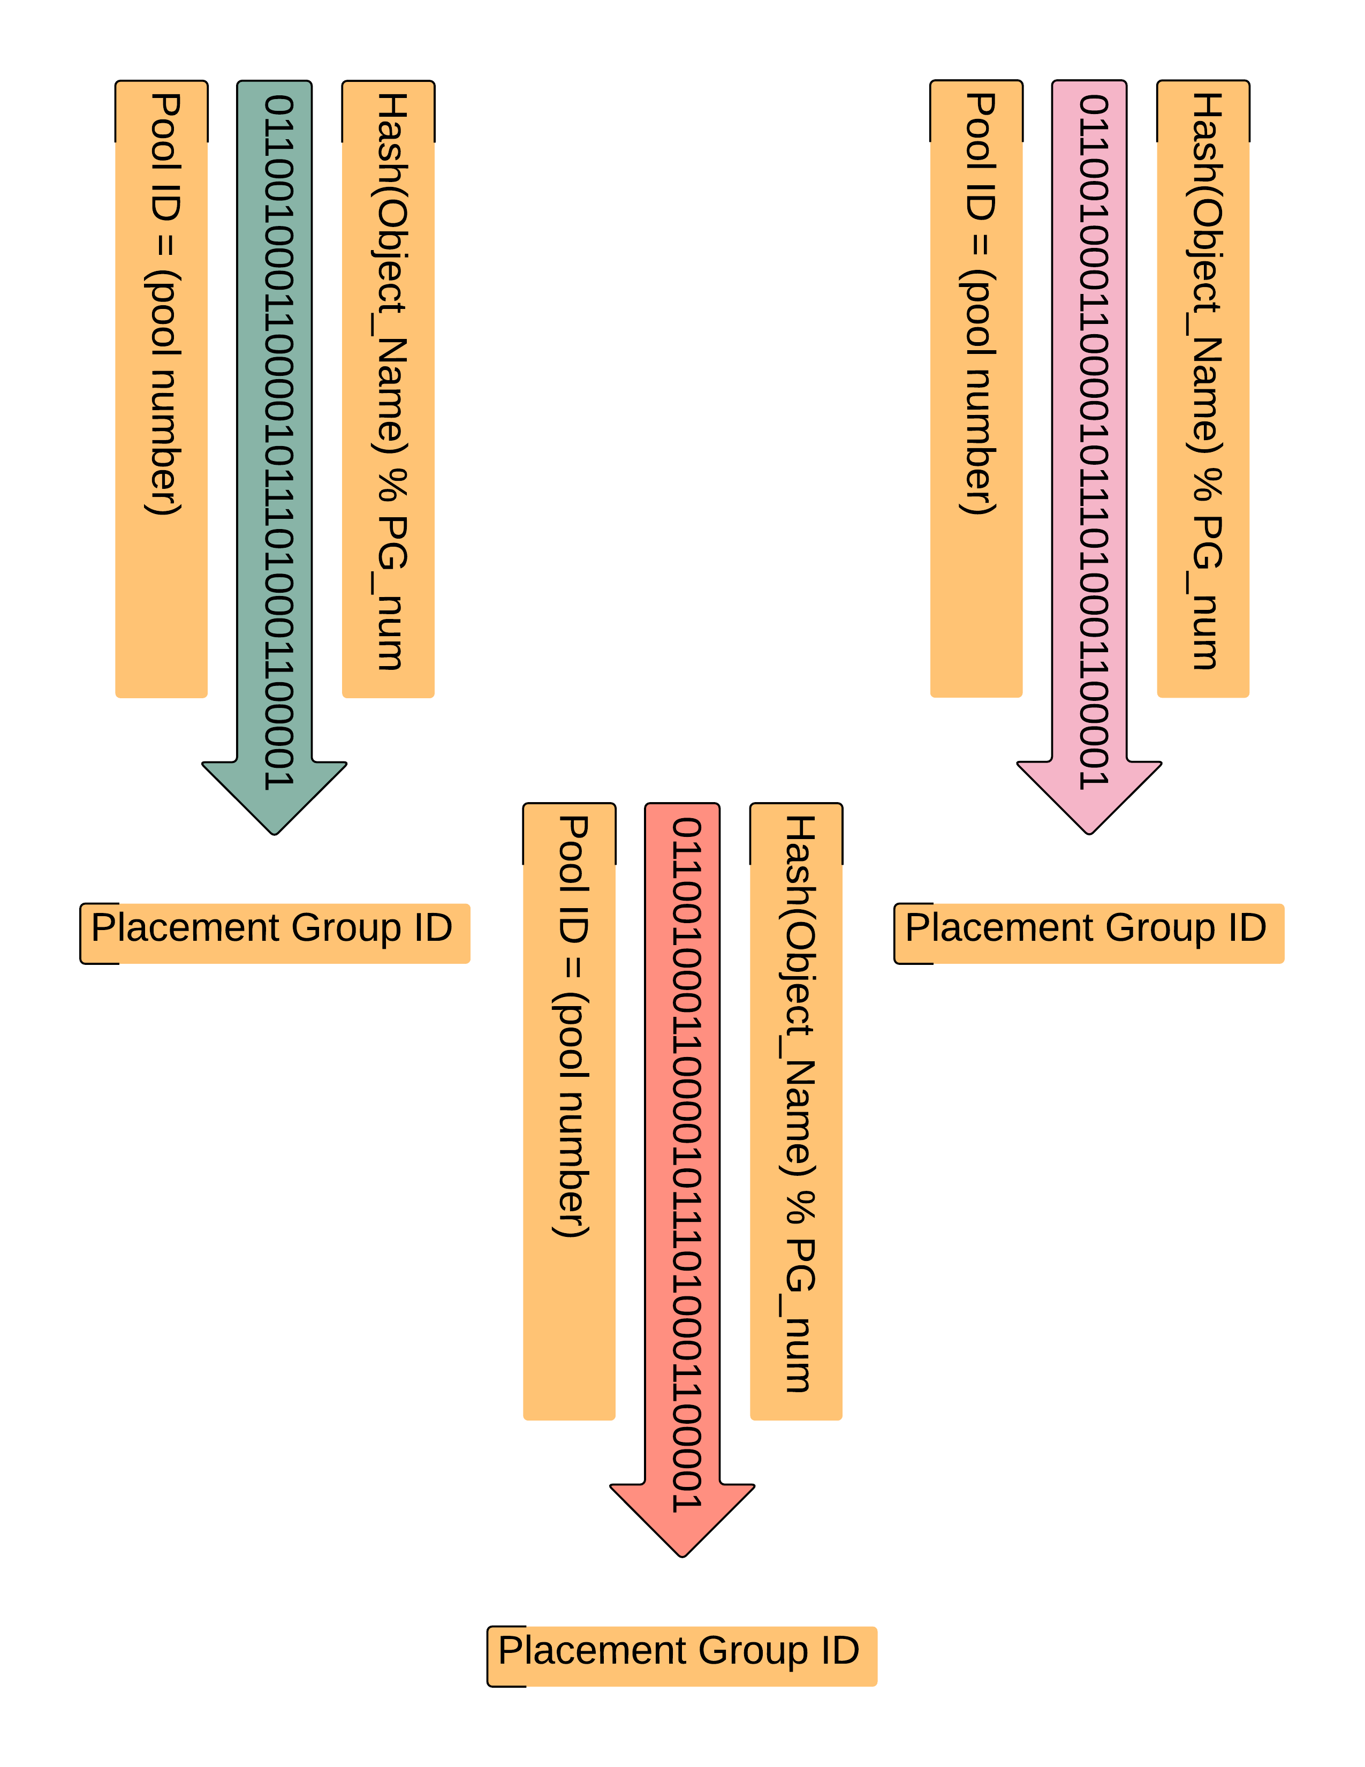

Slide 17
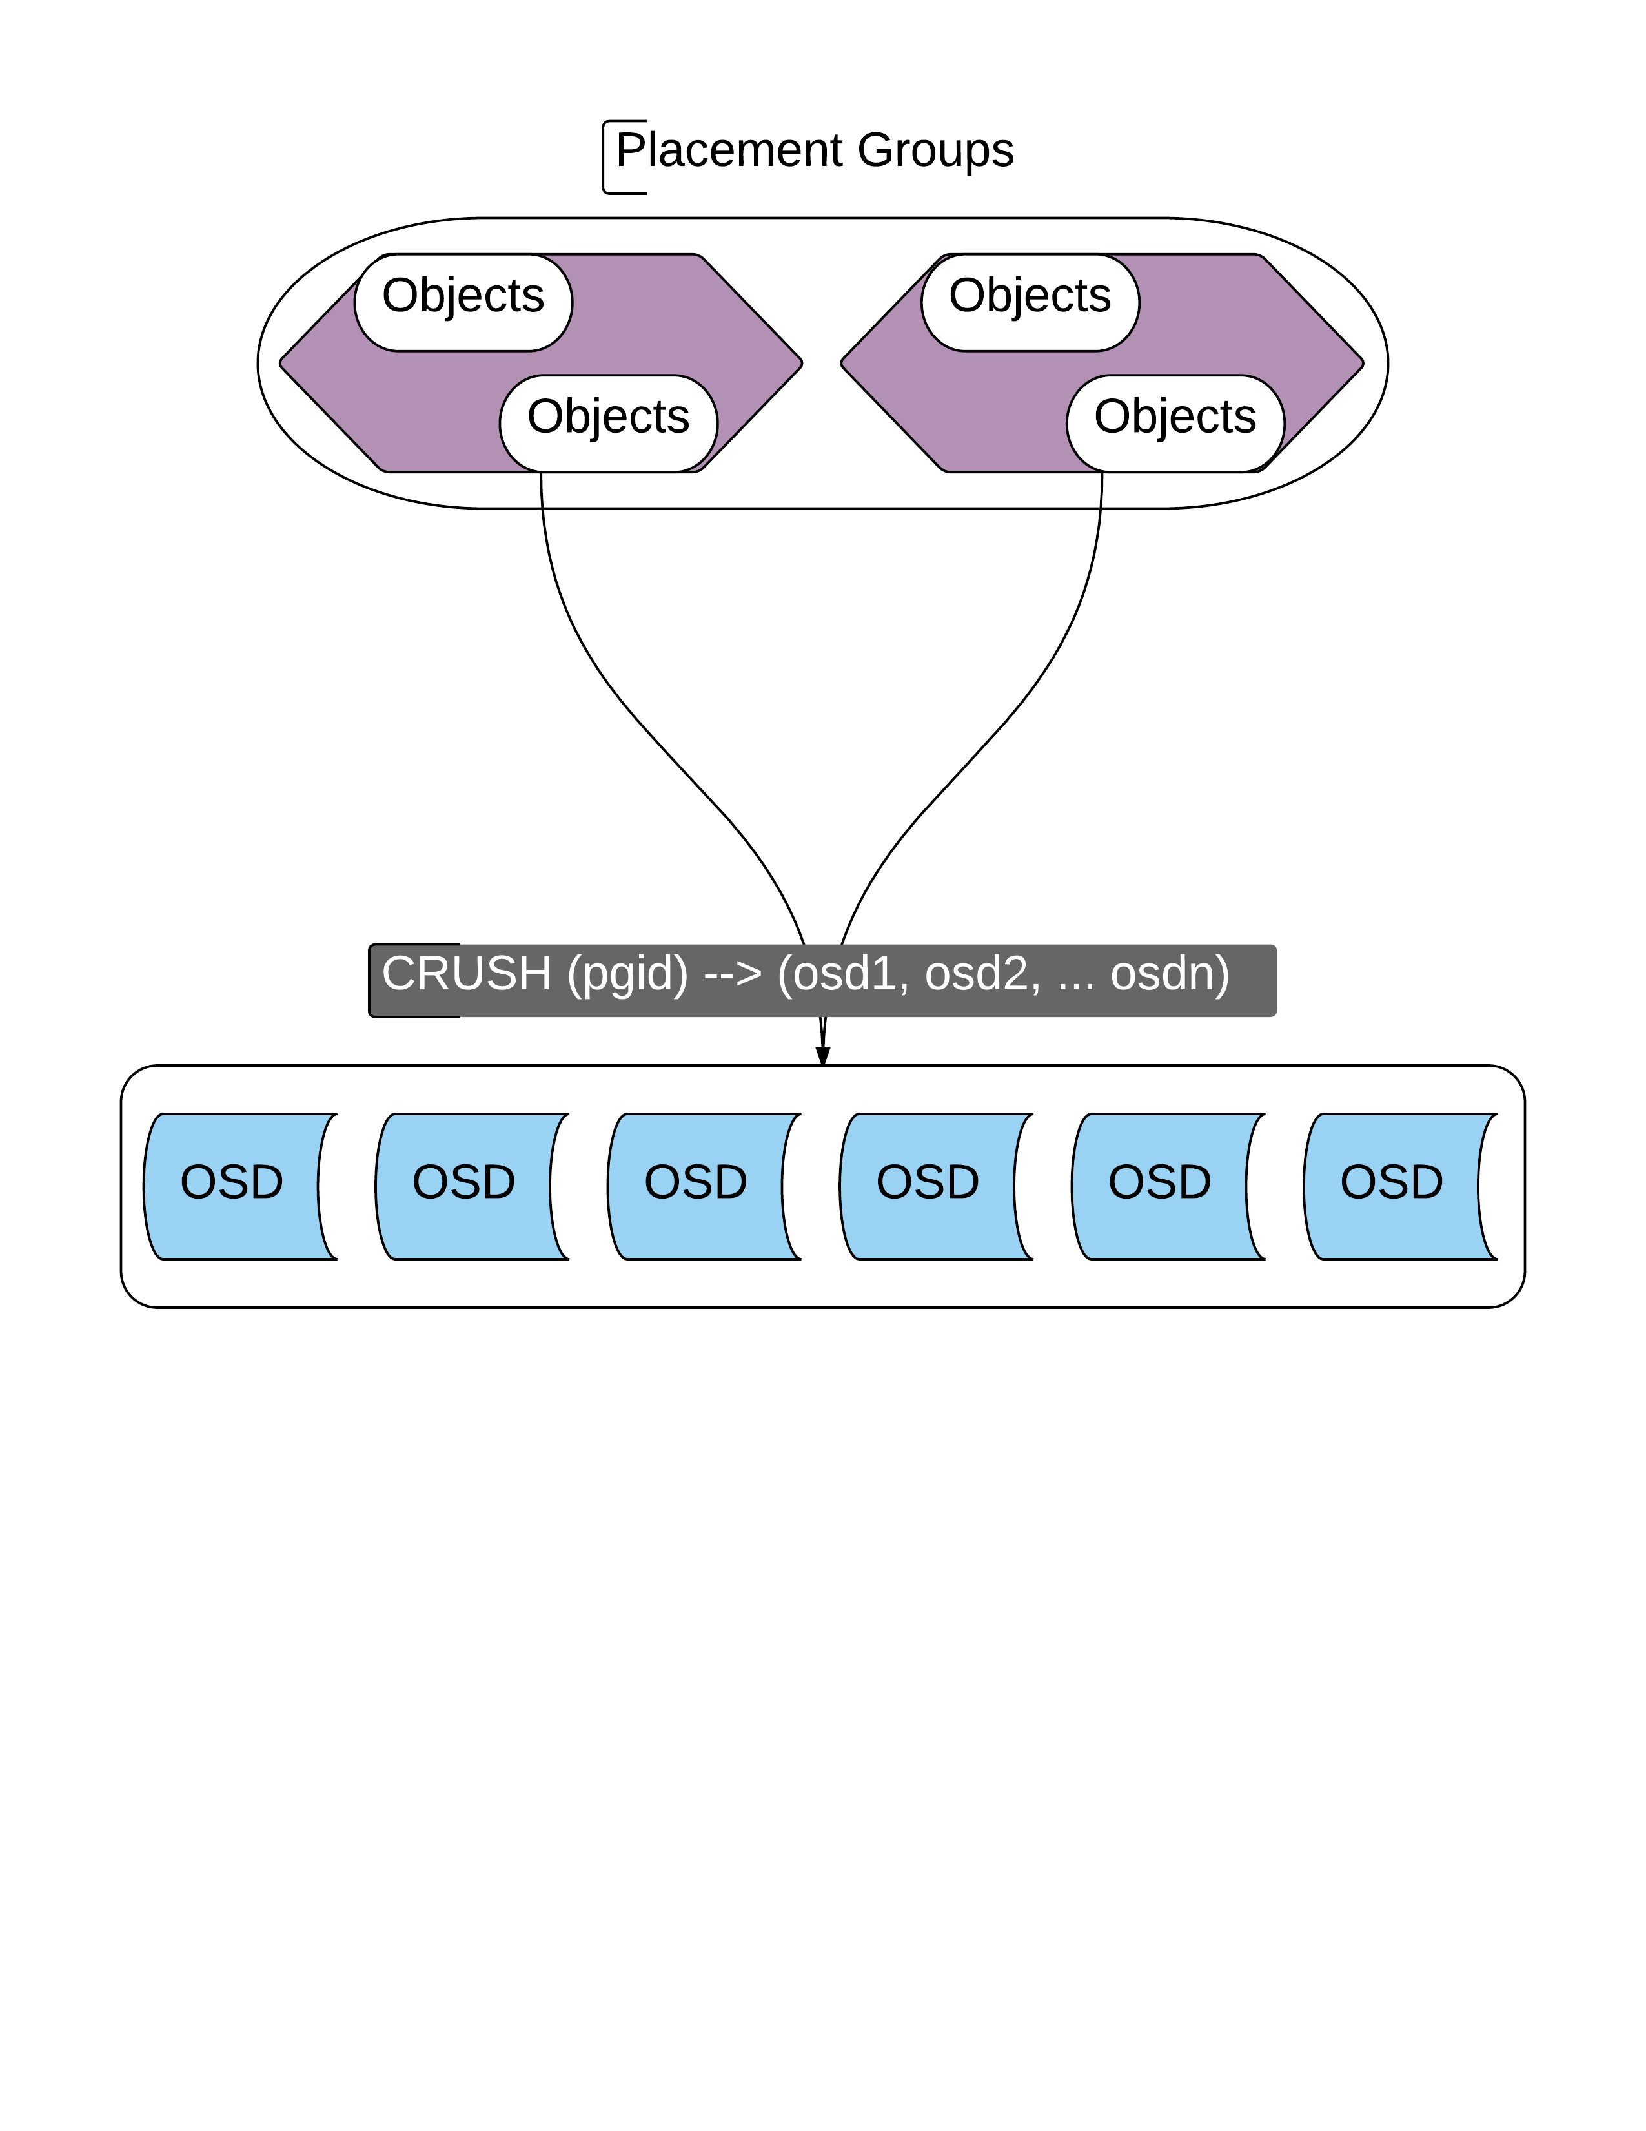

Slide 19
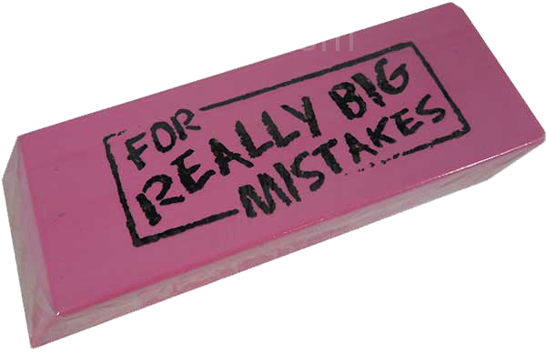
Erasure Coding
High resiliency to data loss
Smaller storage footprint than RAID
Data is broken up into object chunks
Striped across many hard drives
K + M values used to stripe
Various erasure profiles

Slide 20
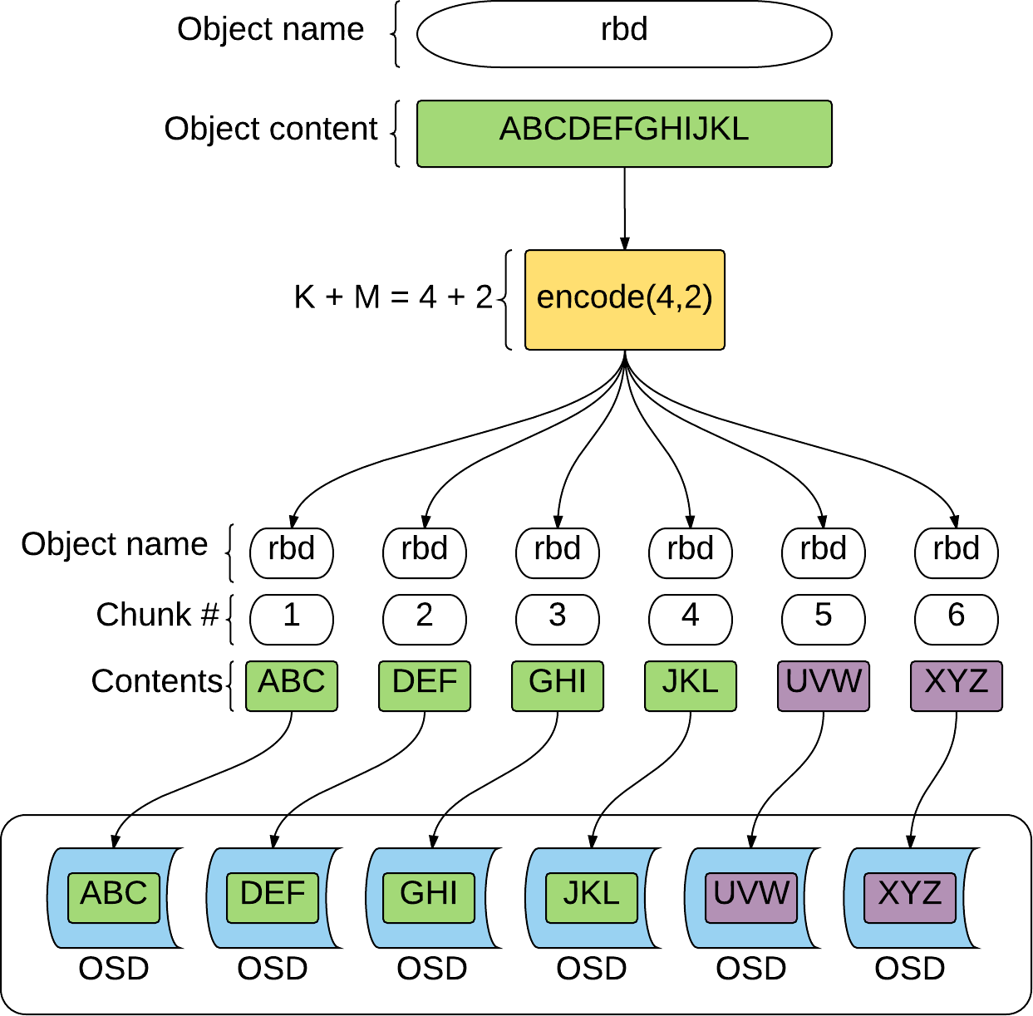
Erasure Coding

Slide 21
Results
Difficult to install and configure Ceph on CentOS 6.6
Multiple proxies write faster than a single proxy
Replicated profile was faster than the erasure coded profiles
K + M values did not significantly affect read and write speeds

Slide 22
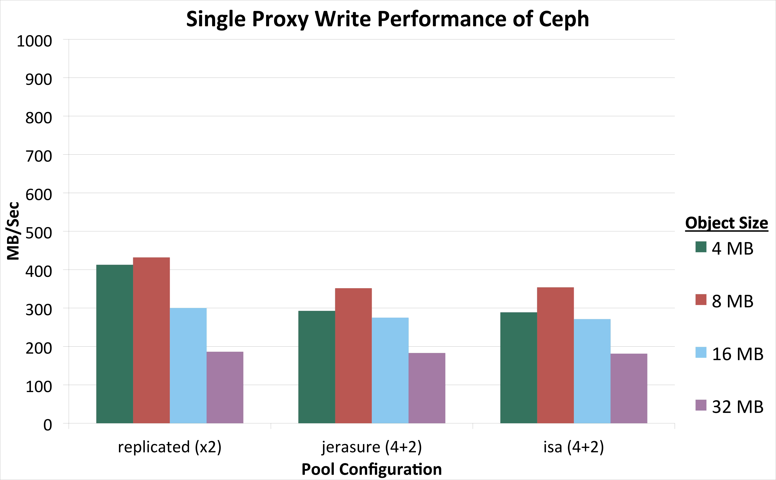

Slide 23
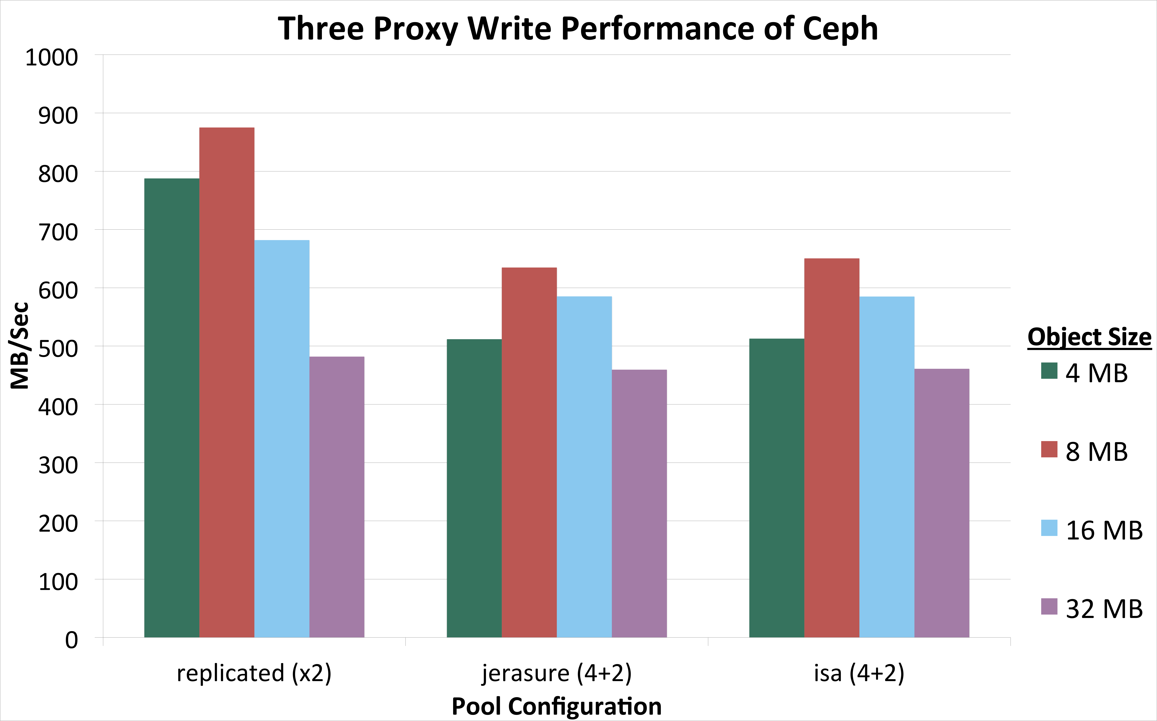

Slide 24
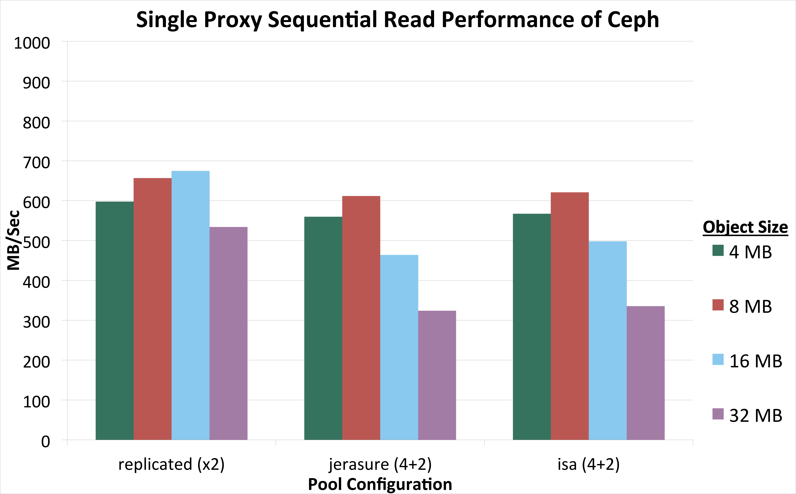

Slide 25

Ceph Headaches
Documentation is inaccurate
Nodes must be configured in specific order
Monitor → OSDs → Proxies
Ceph was unable to recover after hardware failure
Could only use one out of the four Infiniband lanes
Unable to read in parallel

Slide 26
Conclusion
Ceph is difficult to install and configure
Stability of Ceph needs to be improved
Unable to recover from hardware failures during benchmarking
Performance was promising

Slide 27
Future Work
Investigate bottleneck of tests
Further explore pool configurations and PG numbers
Look into Ceph monitoring solutions
Test differences between ZFS/BTRFS vs XFS/EXT4

Slide 28
Acknowledgements
Mentors: David Bonnie, Chris Hoffman, Dominic Manno
Instructors: Matthew Broomfield, assisted by Jarrett Crews
Administrative Staff: Carolyn Connor, Gary Grider, Josephine Olivas, Andree Jacobson

Slide 29

Questions?
Objects stores?
Ceph and our object store?
Installation and configuration?
Pools and Placement groups?
CRUSH?
Erasure coding?
K + M?
28

